Slide 1


AI-driven unstructured
Data extraction
Using
Apache Camel
And Langchain4J

Slide 2

Alexandre Gallice
Red Hat / IBM
@AlexGallice
https://github.com/aldettinger

Slide 3
Plan
Intro (1 min)
Contexts and definitions (4 min)
Explanation of AI related code (6 min)
Explanation of Integration code (3 min)
Lessons learned and next steps (4 min)
Conclusion (1 min)

Slide 4
Unstructured data extraction
Raw/disorganized data from human or machine
Emails, images, audios, transcripts, videos…
Identify entities, properties, relationships, sentiments

Slide 5
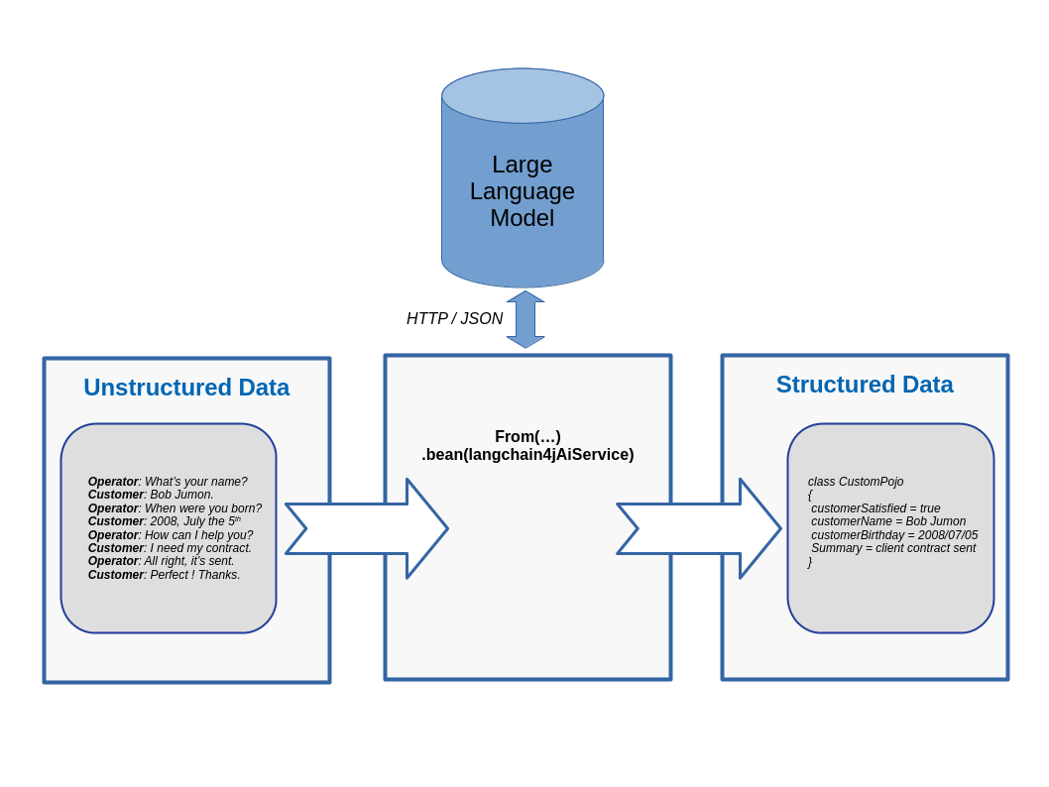
From unstructured text to Java objects

Slide 6
Data set (John Doe)
Operator: Hello, how may I help you ?
Customer: Hello, I'm John. I need to share a problem with you. Actually, the insurance has reimbursed only half the money I have spent due to the accident.
Operator: Hello John, could you please give me your last name so that I can find your contract.
Customer: Sure, my surname is Doe.
Operator: And last thing, I need to know the date you were born.
Customer: Yes, so I was born in 2001, actually during the first day of November.
Operator: Great, I see your contract now. Actually, the full reimbursement option has been cancelled automatically by our system. This explain the half reimbursement.
Customer: Ah damn, this is not acceptable. I've not even been notified about this automatic change.
Operator: Oh, I'm sorry to hear that but the full reimbursement option was free for one year and at the time of subscription you were not interested in automatic renewal.
Customer: I don't discuss that. The important fact is that I should have been notified.
Operator: Sure, I understand your resentment. The best I can do is to inform my manager.
Customer: OK, let's do that. Good bye.
Operator: Good bye. And again let me apologize for the issue.
Name co-reference: Hello, I'm John … my surname is Doe
Birthday format: I was born in 2001, actually during the first day of November
Dissatisfaction slightly suggested: Ah damn, this is not acceptable

Slide 7
Data set (Kate Hart Boss)
Operator: Hello, how may I help you?
Customer: Hello, I am currently at the police station because I've got an accident. The police would need a proof that I have an insurance. Could you please help me?
Operator: Sure, could you please remind me your name and birth date?
Customer: Of course, my name is Kate Hart and I was born on August the thirteen in the year nineteen ninety nine.
Operator: I'm sorry Kate, but we don't have any contract in our records.
Customer: Oh, I'm sorry that I've made a mistake. Actually, my last name is not Hart, but Boss. It changed since I'm married.
Operator: Indeed, I have now found your contract and everything looks good. Shall I send the proof of insurance to the police station?
Customer: Oh, if possible, my husband will go directly to your office in order to get it.
Operator: Yes, that's possible. I will let the paper at the entrance. Your beloved could just ask it to the front desk.
Customer: Many thanks. That's so helpful. I'm a bit more relieved now.
Operator: Sure, you're welcome Kate. Please come back to us any time in case more information is needed. Bye.
Customer: Bye.
Wrong name, later corrected: my name is Kate Hart … Actually … Boss … since I'm married
Birthday format: August the thirteen in the year nineteen ninety nine
Satisfaction straight: That's so helpful. I'm a bit more relieved now

Slide 8
The code in action

Slide 9
Lessons learned and next steps
Reasonable demo achieved with 2B param models
Inference 10-15s (GPU needed for prod like scenarios)
Start by open extraction => model proposes structure

Slide 10
Lessons learned and next steps
Structured output is a key feature
Use classical prompt engineering tricks when needed
Be precise in the ask like “do not create extra field”
Lower temperature for more determinism

Slide 11
Lessons learned and next steps
High level accuracy needed
  Handwriting 95% seen as poor, 97% excellent
  IBM/Mcdo, not enough ROI with 80% accuracy
Experiments with > 100 samples (need GPU)

Slide 12
Lessons learned and next steps
Data extraction augmented with RAG
LLMs to provide a confidence score ?

Slide 13
Questions ? Comments ?
Links: https://github.com/apache/camel-quarkus-examples/tree/main/data-extract-langchain4j

Slide 14
THANK YOU
plus.google.com/+RedHat
facebook.com/redhatinc
linkedin.com/company/red-hat
twitter.com/RedHatNews
youtube.com/user/RedHatVideos

